Slide 1
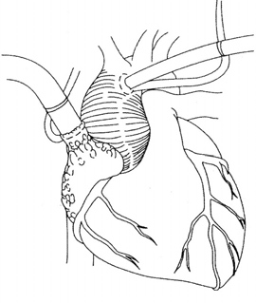
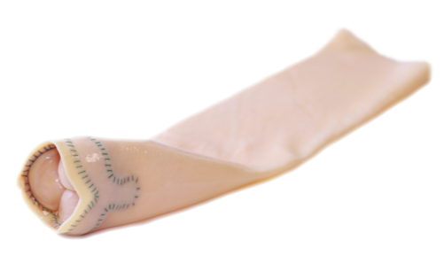
Indications and Technique of Implantation of the BioIntegral No-React BioConduit for Bentall Procedure

Slide 2
Indications
Endocarditis combined with aneurysm of the ascending aorta
Marphan syndrome combined with AR and dilatation of the aorta at any age
Infected graft conduit
Older patients when there is a need to minimize bleeding
Young patients to replace Ross Procedure

Slide 3
Indications
Why No-React BioConduit for young patients? Why to replace Ross Procedure?
No-React valves and conduit found to resist infection, calcification, and remodeling in long-term clinical follow-up
Pulmonic autograft in Ross Procedure is now known to dilate significantly because of remodeling that starts after 3 years, while No-React BioConduit resists dilatation beyond 10 years at any age

Slide 4
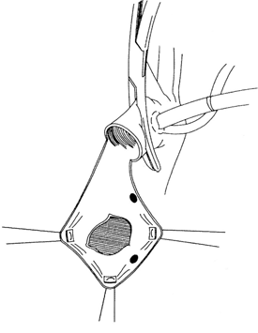
Technique of Implantation
Patient on CPB
Distal cross-clamp
Resect the aneurysm (above the coronary Ostia) & de-calcify if necessary
Figure 1

Slide 5
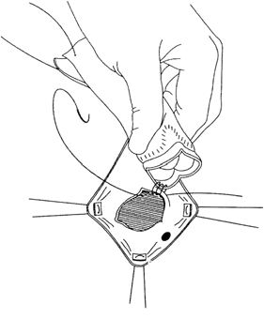
Technique of Implantation
Implanting the annulus of the NR-BioConduit
The suture line of the BioConduit must face the non-coronary cusp
The pericardial annulus of the BioConduit can be sutured with interrupted suture to the aortic annulus (2.0 polyester suture)
Or continuous 3.0 or 4.0 monofilament suture. Advisable to start with 3 commissural site sutures and then run in between – see video
Figure 2

Slide 6
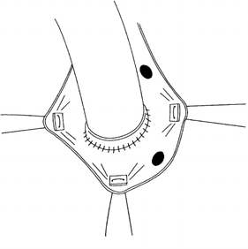
Technique of Implantation
Suturing the Coronary Button
Introduce a right angle clamp and apply outside pressure in the inter-commissural space
Perforate the pericardium with a knife over the right angle guidance
Figure 3

Slide 7
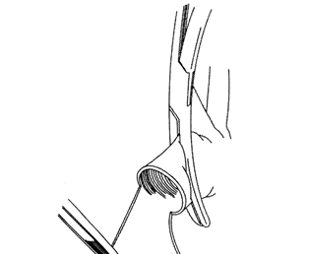
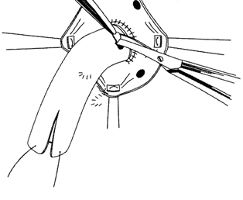
Technique of Implantation
Suturing the Coronary Button
3. Complete the round
perforation with an aortic
punch or scissors as shown in the figure
Figure 4

Slide 8
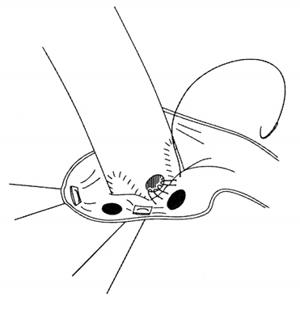
Technique of Implantation
Suturing the Coronary Button
Suture the coronary left and right Ostia to the perforated respective orifice using a continuous 5-0 monofilament suture
Figure 5

Slide 9
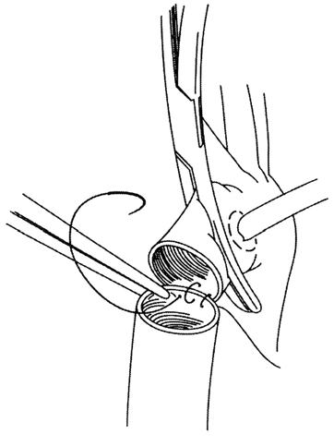
Technique of Implantation
Distal Anastomosis
Transect the conduit in the appropriate length (see video)
Suture the distal part of the conduit to the distal aorta near the clamp using 3.0 or 4.0 monofilament (remember use 2-3mm close bites to assure 100% hemostasis)
Figure 6

Slide 10
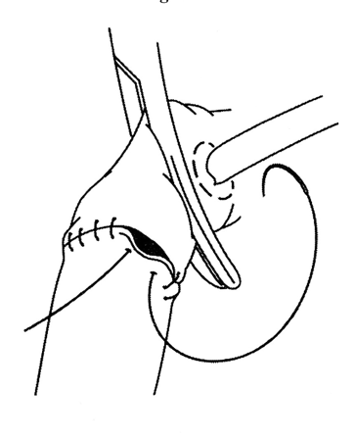
Technique of Implantation
Distal Anastomosis
Let the conduit fill with blood and close the anastomosis
WARNING: any anastomotic bleeding when the patient is off bypass must be secured with 5-0 or 6-0 proline, no oozing permissible, and do not use any aldehyde glue
Figure 7

Slide 11
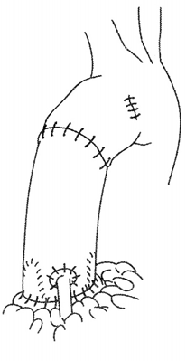
Technique of Implantation
De-clamping
Before you remove the aortic clamp, you can de-air the aorta with a needle
Remove the clamp, and you are ready to go off bypass
Figure 8

Slide 12
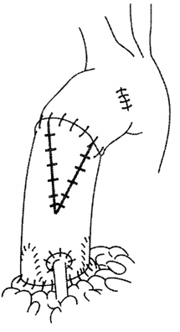
Technique of Implantation
De-clamping
If the diameter of the aorta is larger than the conduit, anastamosis is completed as far is possible and the remaining defect is closed with a No-React pericardial patch (pericardium trimmed from distal end of conduit)
Figure 9

